Slide 1

“Proposal to migrate on-premises infrastructure to cloud”

Slide 2
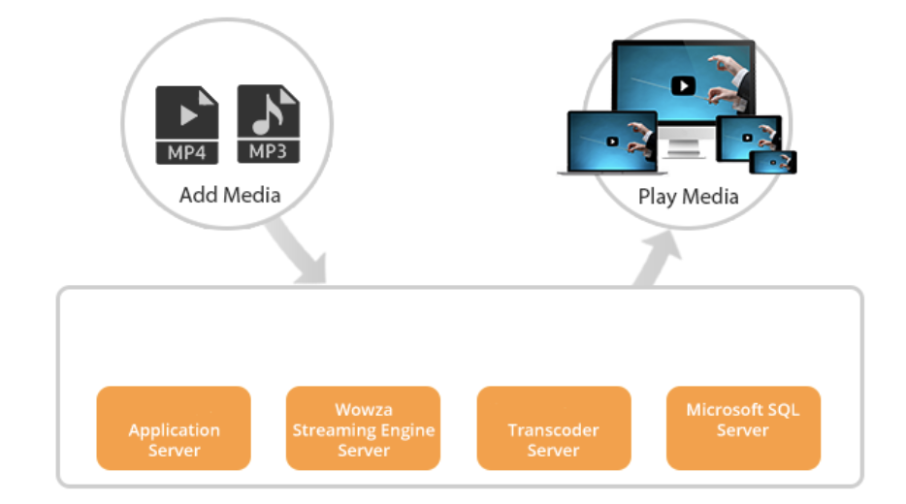
Existing Architecture:

Slide 3
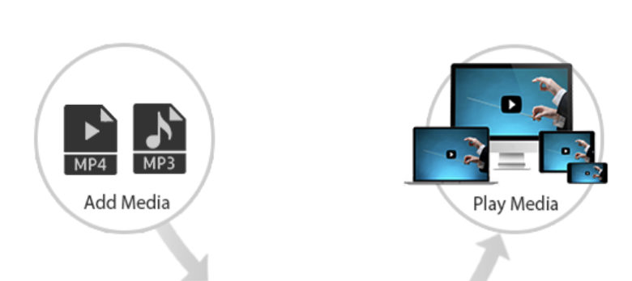
Proposed Architecture:
PaaS (provisioning EC2 for application server and RDS for MySQL server.
IaaS (AWS virtual machine for wowza streaming server)
RESTful web service (Transcoding API for transcoding server)

Slide 4

Backup Methodology: (For video files)
AWS S3
Inbound Data Transfer
AWS S3
Outbound Data Transfer
AWS S3

Slide 5
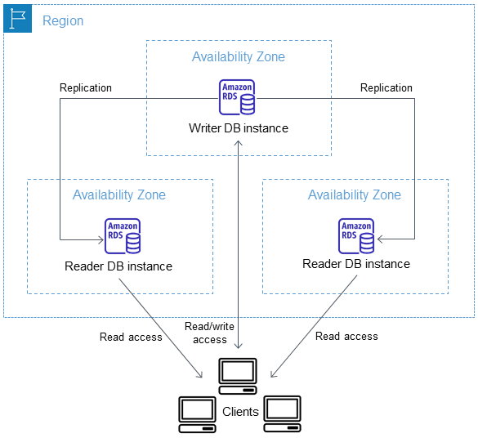
Backup Methodology: (For SQL server)

Slide 6
Customizations to accommodate all the customers say, small, medium & large:
Outbound Streaming video(Small Customers – 1 TB) < Outbound Streaming video(Medium Customers – 10 TB) < Outbound Streaming video(Large Customers – 25 TB)
Inbound traffic – video transcoder(Small Customers – 500 GB) < Inbound traffic – video transcoder(Medium Customers – 3 TB) < Inbound traffic – video transcoder(Large Customers – 6 TB)
Inbound traffic – web application(Small Customers – 250 GB) < Inbound traffic – web application(Medium Customers – 1 TB) < Inbound traffic – web application(Large Customers – 2 TB)
Total video storage(Small Customers – 10 TB(max)) < Total video storage(Medium Customers – 60 TB(max)) < Total video storage(Large Customers – 150 TB(max)

Slide 7
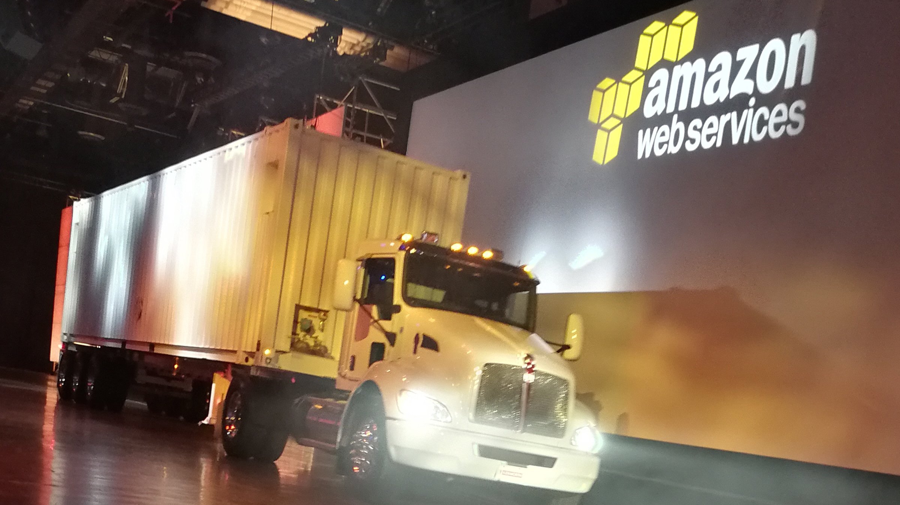
AWS Snowmobile

Slide 8
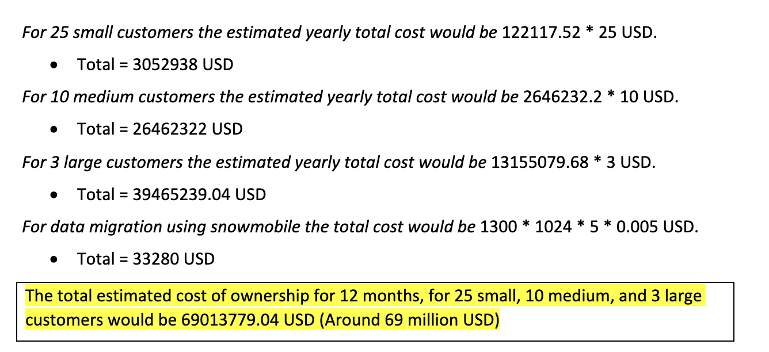
Total Cost of Ownership:

Slide 9
Thank you

